Slide 2
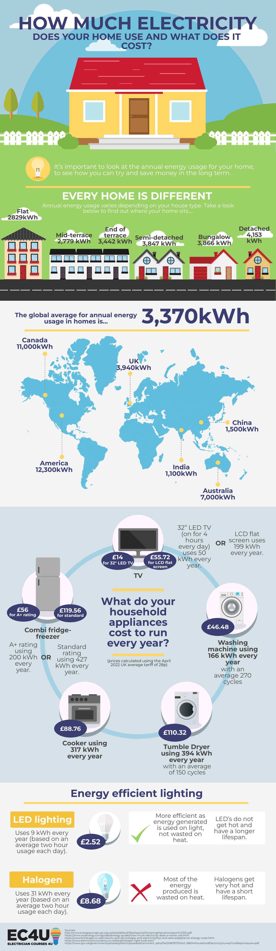
Heating your home efficiently
You may have heard that it’s cheaper to leave the heating on all day. That’s a myth. According to the Energy Saving Trust, the best way is to only have the heating on when you need it.
When you use your boiler timer and room thermostat along with radiator temperature controls (TRVs), you’ll have the most energy-efficient approach to heating your home. (British Gas- 2023)
Notes:
Image from – https://electriciancourses4u.co.uk/useful-resources/how-much-electricity-does-your-home-use/
Text from - https://www.britishgas.co.uk/energy/energy-saving/energy-saving-tips.htmL

Slide 3
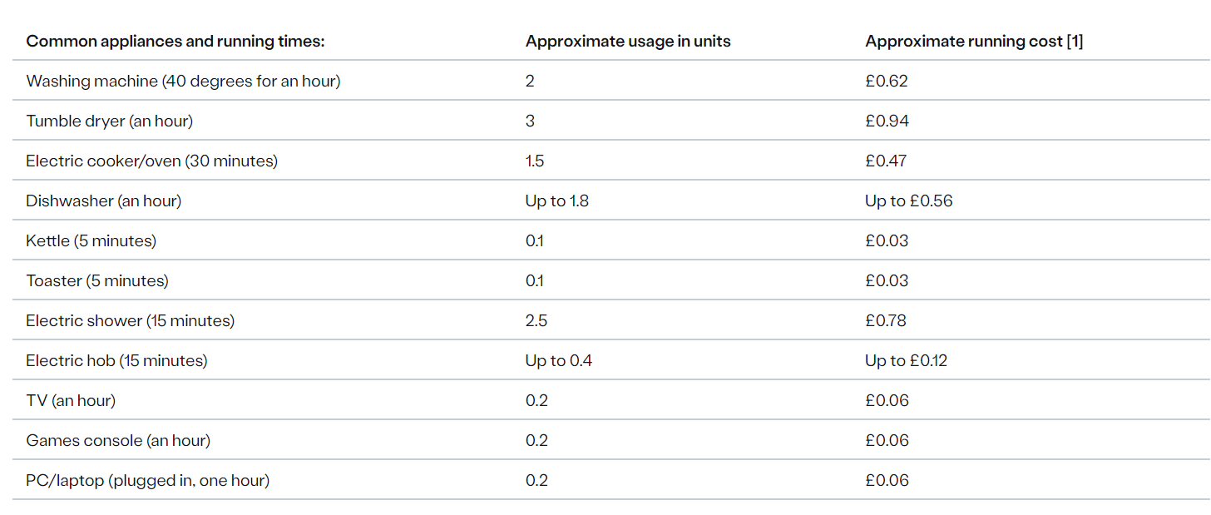
Understanding your electricity bill: “always on” appliances
These are designed to be left switched on all the time, so there’s not much you can do to save on their energy costs. However, once they reach the end of their lifespan, it’s a good idea to compare energy ratings to make sure you buy an energy-efficient replacement. (British gas 2023)
Notes:
Image from – https://electriciancourses4u.co.uk/useful-resources/how-much-electricity-does-your-home-use/
Text from - https://www.britishgas.co.uk/energy/energy-saving/energy-saving-tips.htmL
Chart - https://www.britishgas.co.uk/energy/energy-saving/energy-saving-tips.htmL#appliances

Slide 4
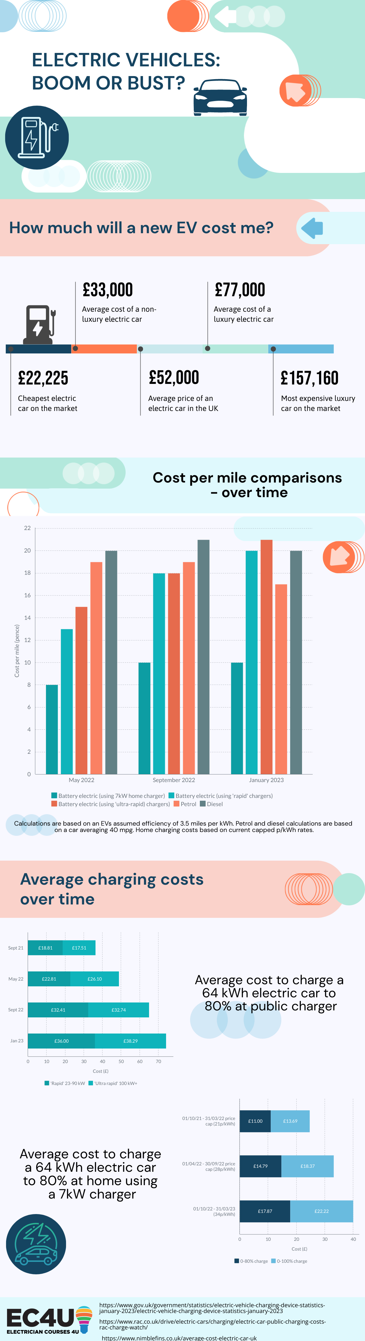
Thinking of an Electric Vehicle?
Notes:
Images - https://electriciancourses4u.co.uk/useful-resources/electric-vehicles-boom-or-bust/

Slide 5
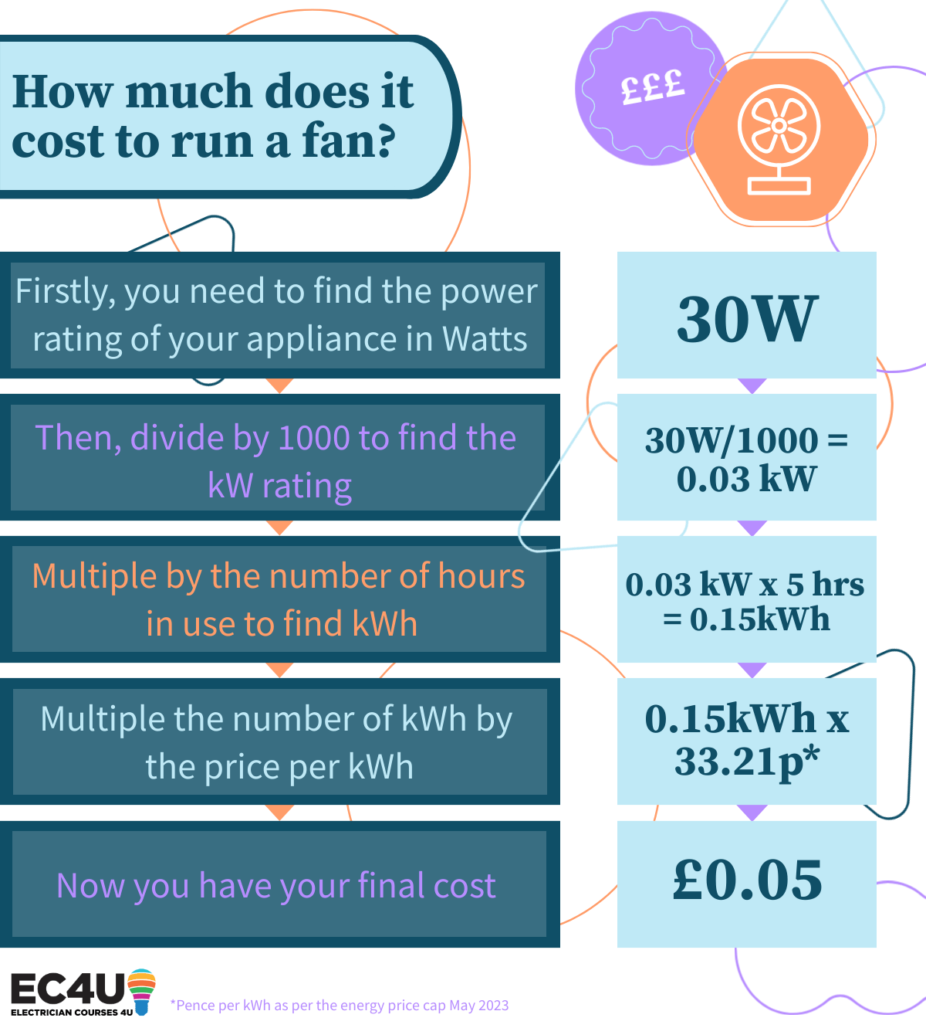
The price of a fan can vary dramatically depending on where you are looking. Remember if you are buying from an online retailer do not always believe the reviews as these are easy to influence, if the price seems too good to be true, then it probably is!
The cost to run a fan will very much vary depending on your fan’s Watt rating, the price you pay per kWh and how long you intend to run the fan for so once you have all these figures use the simple equation below to find out how much your fan will cost you! (electriciancourses4u.co.uk, 2023)
Notes:
Image and text from - https://electriciancourses4u.co.uk/useful-resources/the-cost-of-keeping-cool/

Slide 6

The UK Government has committed to investing in renewable energy technology to eliminate emissions and tackle climate change, with a focus on moving from fossil fuels to home-grown, clean energy. As part of their Energy Security Plan and efforts to achieve net zero carbon emissions by 2050, the Government has introduced a number of incentives to encourage homeowners to upgrade to low-carbon or renewable energy technologies.
(https://electriciancourses4u.co.uk/blog/renewable-energy-incentives-update-2023/)
Notes:
Text - (https://electriciancourses4u.co.uk/blog/renewable-energy-incentives-update-2023/)
Image - (https://electriciancourses4u.co.uk/blog/renewable-energy-incentives-update-2023/)

Slide 7

The Government Boiler Upgrade Scheme
A heat pump is an energy-efficient device that takes heat from an existing source and uses it to increase the internal temperature of a building. As well as having a much lower carbon footprint, they are much more efficient than fossil fuel systems. The Government’s Boiler Upgrade Scheme (BUS). This grant can be used to cover some or all of the costs associated with replacing a fossil fuel heating system with a heat pump or biomass boiler.
The BUS allows eligible households to apply for:
– £5,000 towards an air source heat pump
– £6,000 towards a ground source heat pump
– £5,000 towards a biomass boiler
Notes:
Text - https://electriciancourses4u.co.uk/blog/renewable-energy-incentives-update-2023/
Image - https://www.thegreenage.co.uk/boiler-upgrade-scheme-extended/

Slide 8

Smart Export Guarantee
The Smart Export Guarantee (SEG) is a government-backed initiative launched on January 1st 2020. The SEG requires some electricity suppliers to purchase low-carbon electricity from small-scale generators, providing certain criteria are met. The energy is then exported back to the National Grid.
While this initiative doesn’t provide any financial assistance for the installation of clean energy technologies, it does help to offset the costs by ensuring that households and businesses with small-scale renewable technologies are paid for their excess electricity. The average home is able to make £159 per year through the SEG.

Slide 9
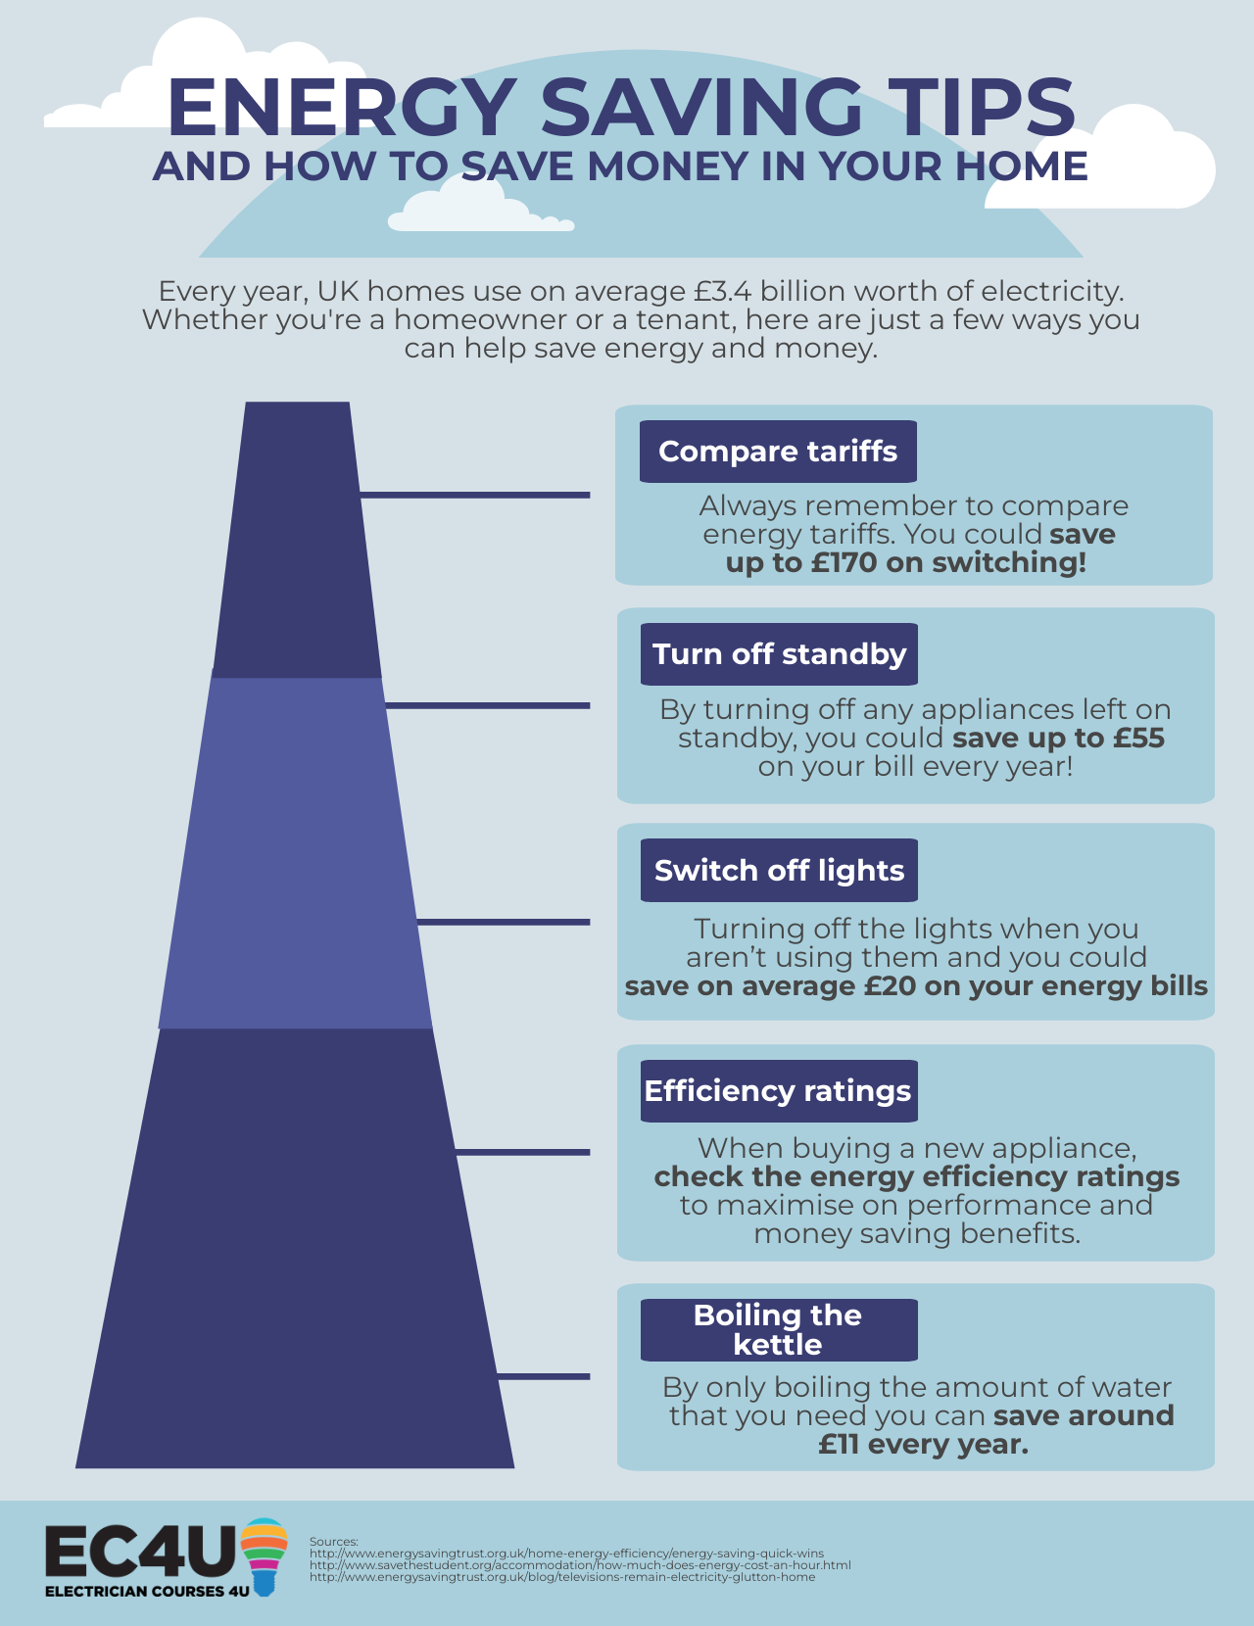
Energy efficiency ratings are important to consider when buying new appliances as a higher rating can mean it will help save you money and electricity. Use the ratings as a guide to get the optimum performance and money saving benefits from your appliance. The energy efficiency guide was put in place to help you choose the right appliance for your home.
Notes:
Text and images - https://electriciancourses4u.co.uk/useful-resources/how-much-electricity-does-your-home-use/

Slide 10
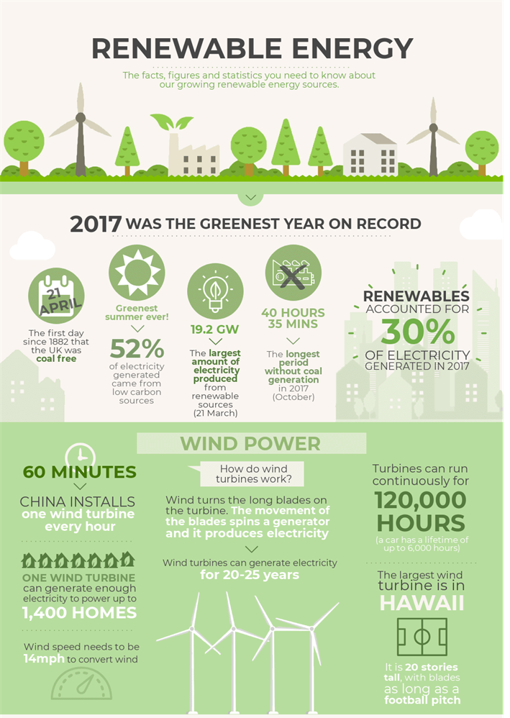
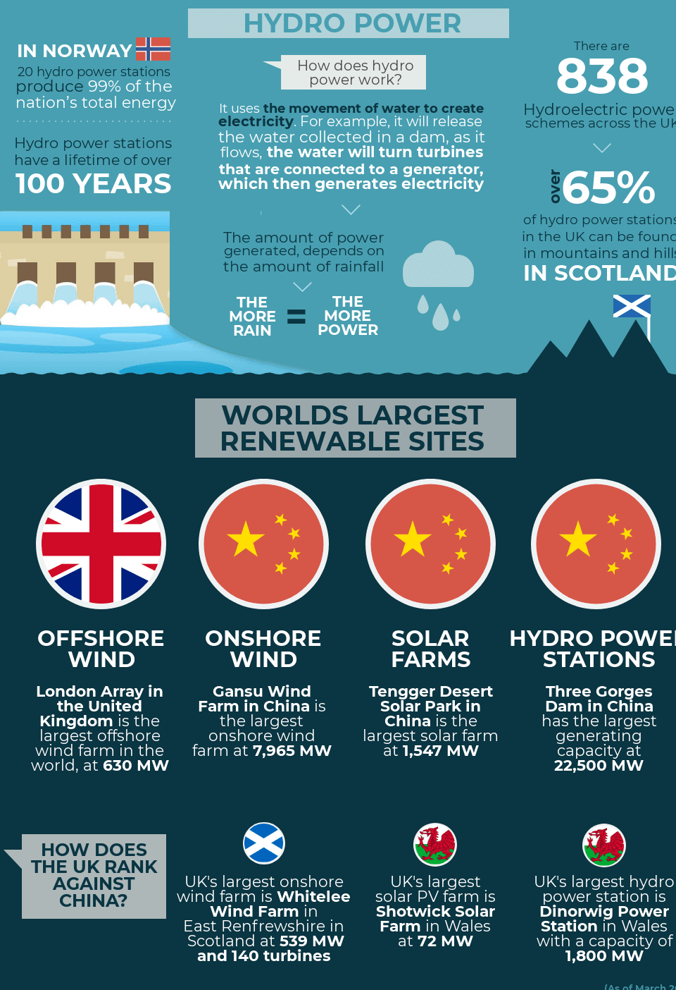
Notes:
Images - https://electriciancourses4u.co.uk/useful-resources/renewable-energy-the-facts-and-how-it-works/

Slide 11







